Slide 1
Conversion of E-R Diagram to Tables
Handling of Relationships

Slide 2
Conversion of E-R Diagram to Tables
Handling of Many to One Type Relationships

Slide 3
Connectivity of a Relationship
The connectivity of a relationship describes the mapping of associated entity instances in the relationship. The values of connectivity are "one" or "many".
One to One (1:1)
One to Many (1:M)
Many to One (M:1)
Many to Many (M:M)

Slide 4
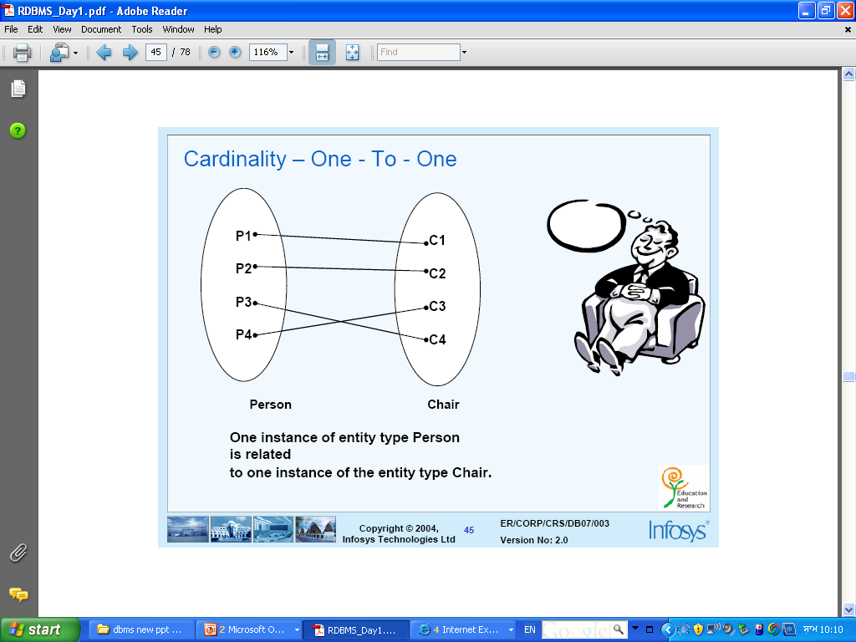
Connectivity of a Relationship

Slide 5
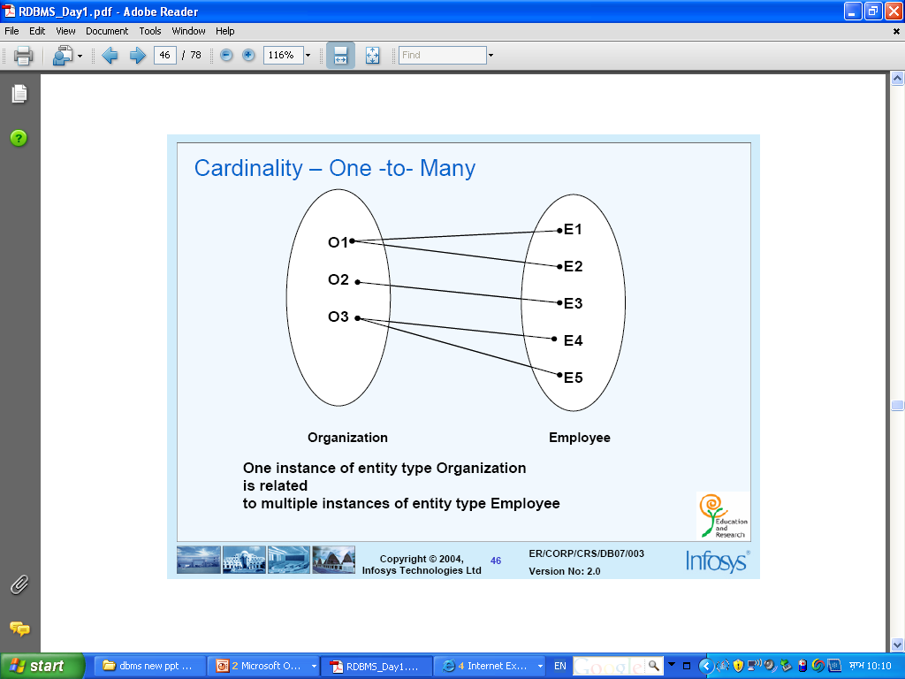
Connectivity of a Relationship

Slide 6
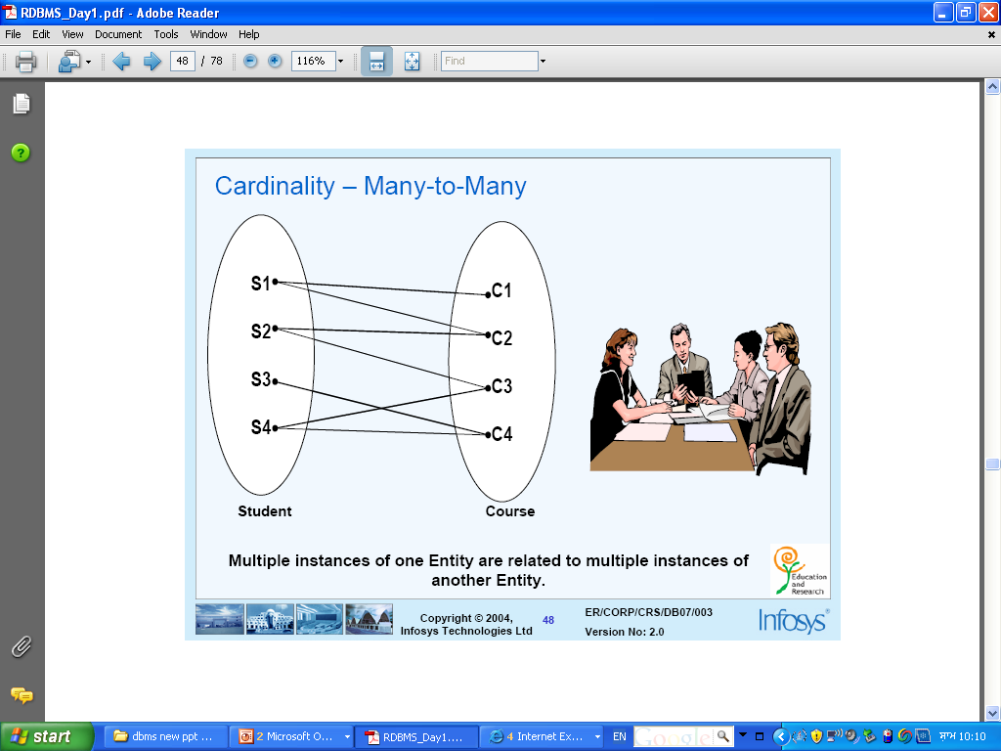
Connectivity of a Relationship

Slide 7
Find out the type of Connectivity
Student and Teacher Entity Sets
Answer: Many to Many
Team and Captain Entity Sets
Answer: One to One
Student and Department Entity Sets
Answer: Many to One
College and Society Entity Sets
Answer: One to Many

Slide 8
Handling of Many to Many Type of Relationship
Rollno
Name
Address
TCode
TName
TAddress
ST
STUDENT
TEACHER

Slide 9
Handling of Many to Many Type of Relationship
Rollno
Name
Address
TCode
TName
TAddress
ST
STUDENT
TEACHER
Rule:
For every many to many type of relationship create a separate table for the relationship involving primary key of all participating entity sets.

Slide 10
Conversion of E-R Diagram to Tables
Handling of Many to One Type Relationships

Slide 11
Handling of Many to One Type of Relationship
Rollno
Name
Address
CCode
CName
CAddress
SC
STUDENT
College

Slide 12
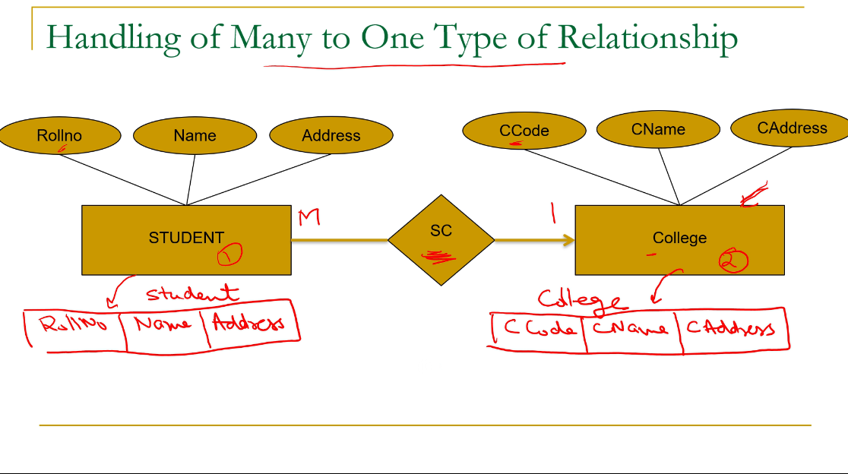


Slide 13
Handling of Many to One Type of Relationship
Rollno
Name
Address
CCode
CName
CAddress
SC
STUDENT
College
Rule:
For every many to one type of relationship, there is no need to create a separate table for the relationship.
Copy the primary key of one entity set towards many entity set.

Slide 14
Conversion of E-R Diagram to Tables
Handling of One to Many Type Relationships

Slide 15
Handling of One to Many Type of Relationship
CCode
CName
CAddress
Deptno
DName
DAddress
DC
COLLEGE
DEPT

Slide 16
Handling of One to Many Type of Relationship
CCode
CName
CAddress
Deptno
DName
DAddress
DC
COLLEGE
DEPT
Rule:
For One to Many type of relationship, there is no need to create a separate table for the relationship.
Copy the primary key of one entity set towards many entity set.

Slide 17
Conversion of E-R Diagram to Tables
Handling of One to One Type Relationships

Slide 18
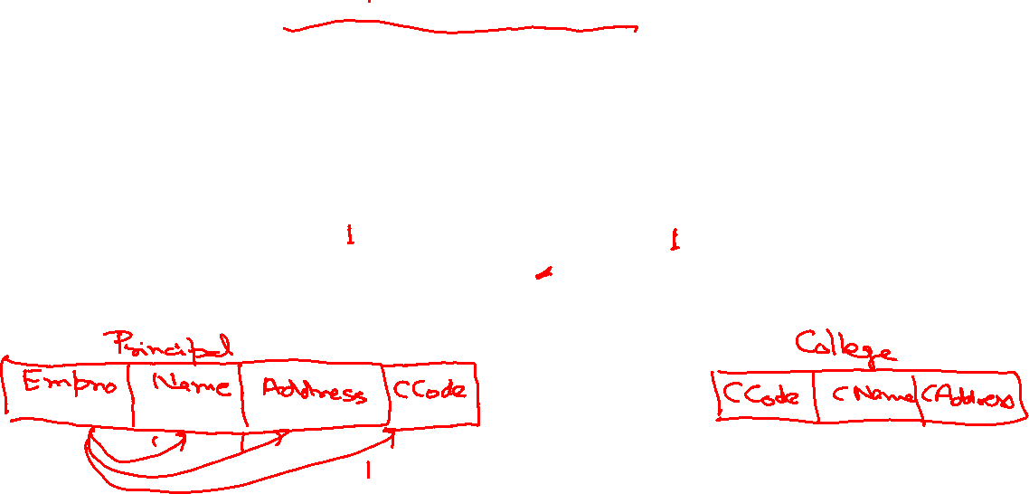
Handling of One to One Type of Relationship
Empno
Name
Address
CCode
CName
CAddress
PC
Principal
College

Slide 19
Handling of One to One Type of Relationship
Empno
Name
Address
CCode
CName
CAddress
PC
Principal
College

Slide 20
Handling of One to One Type of Relationship
Empno
Name
Address
CCode
CName
CAddress
PC
Principal
College

Slide 21
Handling of One to One Type of Relationship
Empno
Name
Address
CCode
CName
CAddress
PC
Principal
College
Rule:
For One to One type of relationship, there is no need to create a separate table for the relationship.
Copy the primary key of any of one entity set towards another entity set.

Slide 22
Handling of One to One Type of Relationship
Cno
Name
Address
LNo
Amount
Balance
CL
Customer
Loan

Slide 23
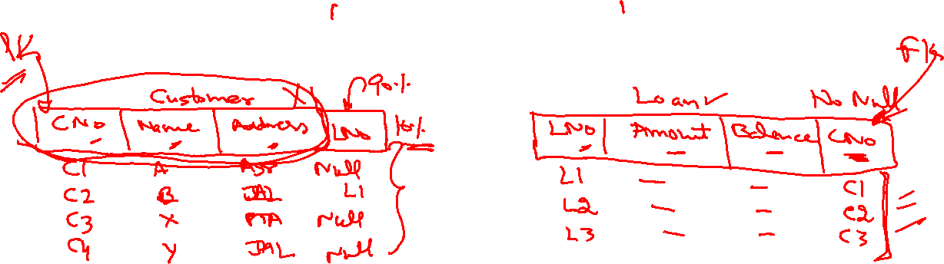
Handling of One to One Type of Relationship
Cno
Name
Address
LNo
Amount
Balance
CL
Customer
Loan

Slide 24
Handling of One to One Type of Relationship
Cno
Name
Address
LNo
Amount
Balance
CL
Customer
Loan

Slide 25
Handling of One to One Type of Relationship
Cno
Name
Address
LNo
Amount
Balance
PC
Customer
Loan
Rule:
If you have any of entity set with total participation, then always copy primary key of one entity set towards an entity set having total participation.

